Slide 1

Chapter 5 Analog Transmission
5.1
Copyright © The McGraw-Hill Companies, Inc. Permission required for reproduction or display.

Slide 2
5-1 DIGITAL-TO-ANALOG CONVERSION
Digital-to-analog conversion is the process of changing one of the characteristics of an analog signal based on the information in digital data.
Topics discussed in this section: Aspects of Digital-to-Analog Conversion Amplitude Shift Keying
Frequency Shift Keying Phase Shift Keying
Quadrature Amplitude Modulation
5.2

Slide 3
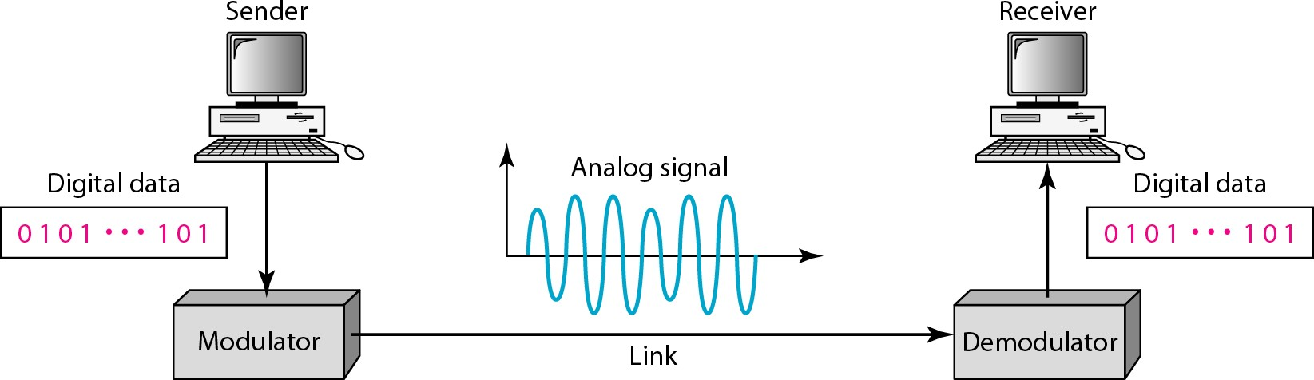
Figure 5.1 Digital-to-analog conversion
5.3

Slide 4
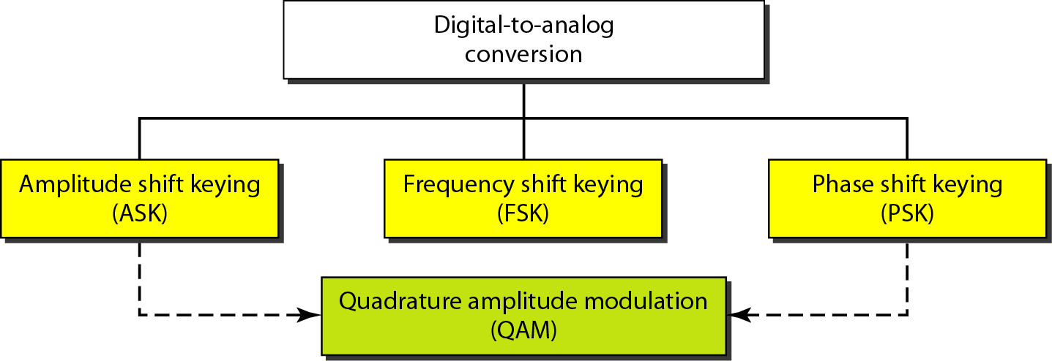
Figure 5.2 Types of digital-to-analog conversion
5.4

Slide 5

Note
Bit rate is the number of bits per second. Baud rate is the number of signal
elements per second.
In the analog transmission of digital data, the baud rate is less than
or equal to the bit rate.
5.5

Slide 6
Example 5.1
An analog signal carries 4 bits per signal element. If 1000 signal elements are sent per second, find the bit rate.
Solution
In this case, r = 4, S = 1000, and N is unknown. We can find the value of N from
5.6

Slide 7
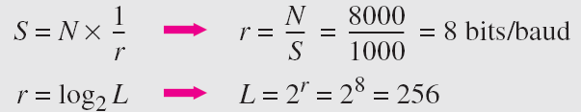
Example 5.2
An analog signal has a bit rate of 8000 bps and a baud rate of 1000 baud. How many data elements are carried by each signal element? How many signal elements do we need?
Solution
In this example, S = 1000, N = 8000, and r and L are unknown. We find first the value of r and then the value of L.
5.7

Slide 8
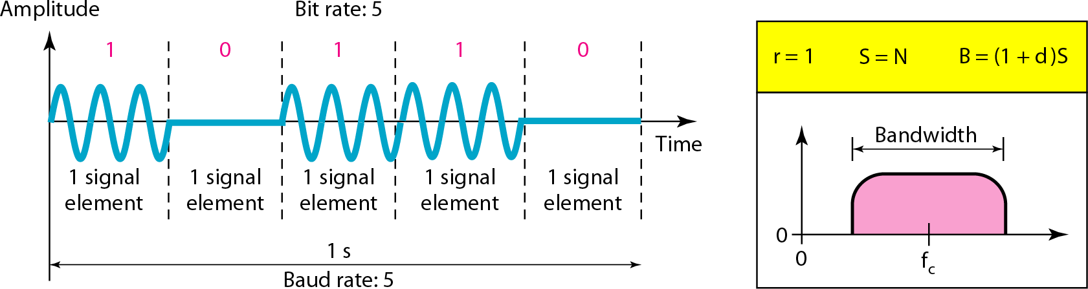
Figure 5.3 Binary amplitude shift keying
5.8

Slide 9
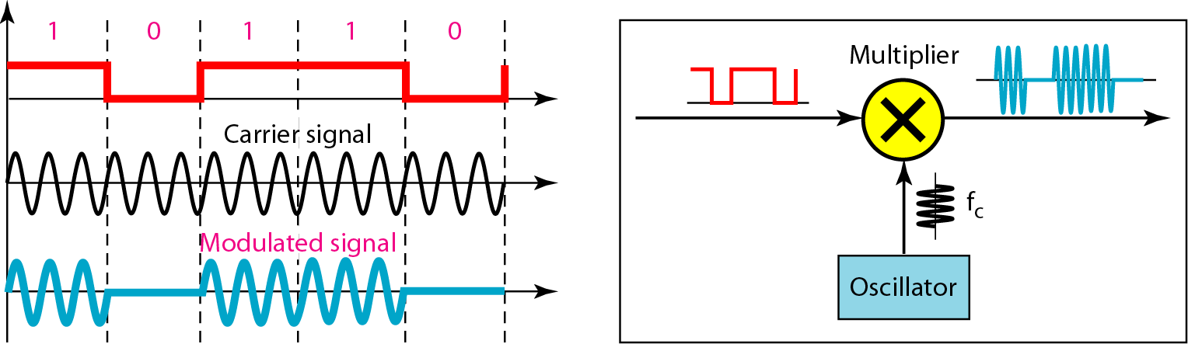
Figure 5.4 Implementation of binary ASK
5.9

Slide 10
Example 5.3
We have an available bandwidth of 100 kHz which spans from 200 to 300 kHz. What are the carrier frequency and the bit rate if we modulated our data by using ASK with d = 1?
Solution
The middle of the bandwidth is located at 250 kHz. This means that our carrier frequency can be at f_{c} = 250 kHz.
We can use the formula for bandwidth to find the bit rate (with d = 1 and r = 1).

Slide 11
Example 5.4
In data communications, we normally use full-duplex links with communication in both directions. We need to divide the bandwidth into two with two carrier frequencies, as shown in Figure 5.5. The figure shows
the positions of two carrier frequencies
and the bandwidths. The available bandwidth for each
direction is now 50 kHz, which leaves us with a data rate of 25 kbps in each direction.

Slide 12
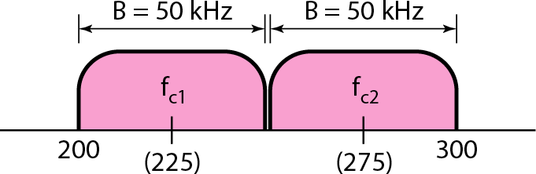
Figure 5.5 Bandwidth of full-duplex ASK used in Example 5.4

Slide 13
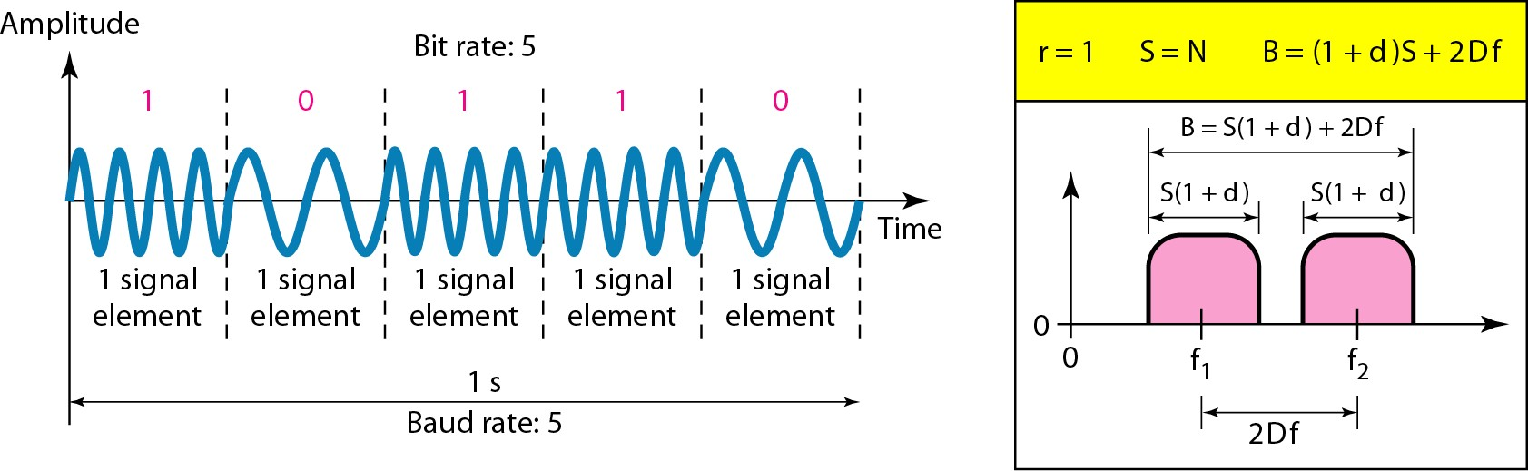
Figure 5.6 Binary frequency shift keying

Slide 14
Example 5.5
We have an available bandwidth of 100 kHz which spans from 200 to 300 kHz. What should be the carrier frequency and the bit rate if we modulated our data by using FSK with d = 1?
Solution
This problem is similar to Example 5.3, but we are modulating by using FSK. The midpoint of the band is at 250 kHz. We choose 2Δf to be 50 kHz; this means

Slide 15
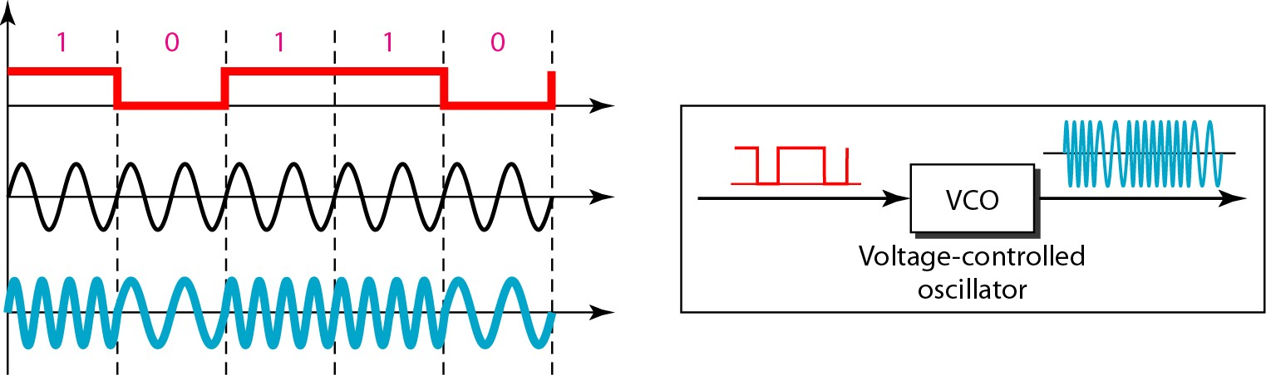
Figure 5.7 Implementation of BFSK

Slide 16
Example 5.6
We need to send data 3 bits at a time at a bit rate of 3 Mbps. The carrier frequency is 10 MHz. Calculate the number of levels (different frequencies), the baud rate, and the bandwidth.
Solution
We can have L = 2^3 = 8. The baud rate is S = 3 MHz/3 = 1000 Mbaud. This means that the carrier frequencies must be 1 MHz apart (2Δf = 1 MHz). The bandwidth is B
= 8 × 1000 = 8000. Figure 5.8 shows the allocation of frequencies and bandwidth.

Slide 17
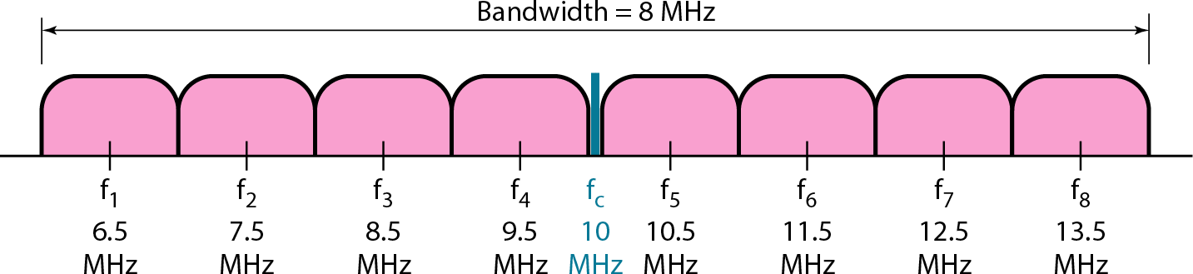
Figure 5.8 Bandwidth of MFSK used in Example 5.6

Slide 18
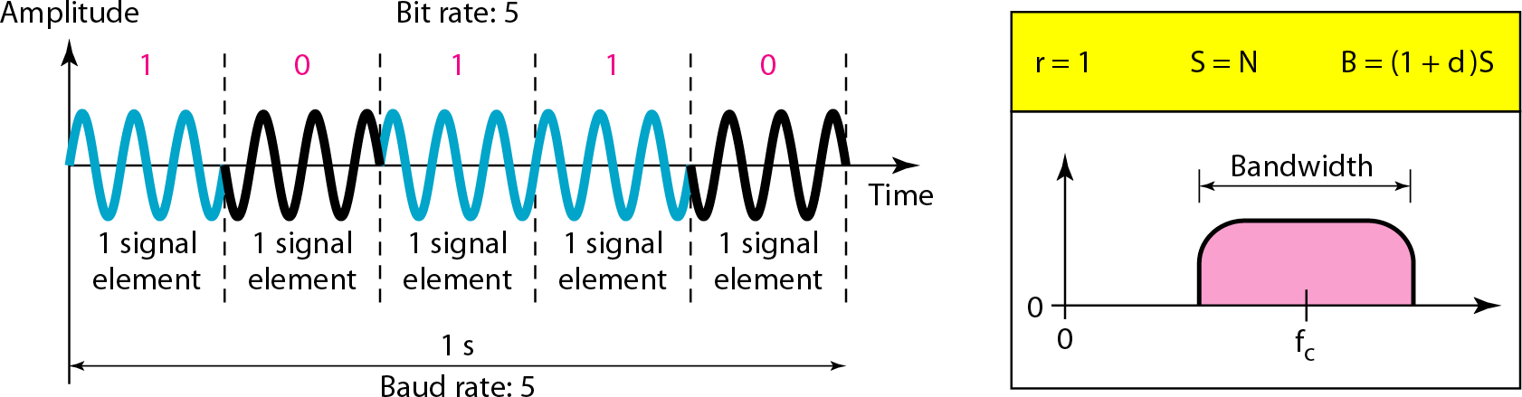
Figure 5.9 Binary phase shift keying

Slide 19
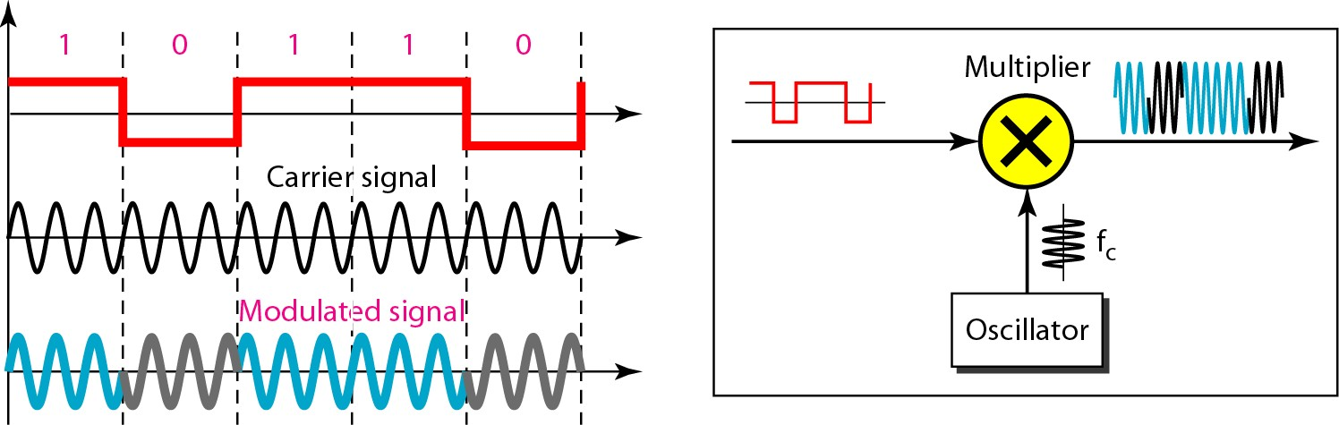
Figure 5.10 Implementation of BPSK

Slide 20
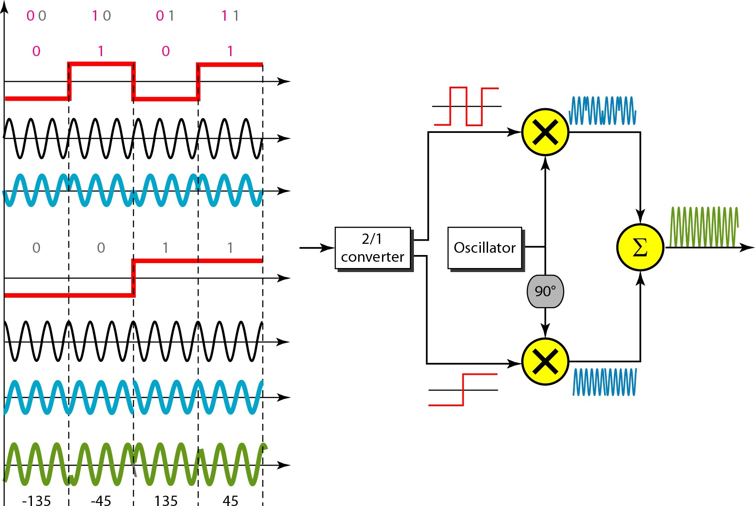
Figure 5.11 QPSK and its implementation

Slide 21
Example 5.7
Find the bandwidth for a signal transmitting at 12 Mbps for QPSK. The value of d = 0.
Solution
For QPSK, 2 bits is carried by one signal element. This means that r = 2. So the signal rate (baud rate) is S = N × (1/r) = 6 Mbaud. With a value of d = 0, we have B = S = 6 MHz.

Slide 22
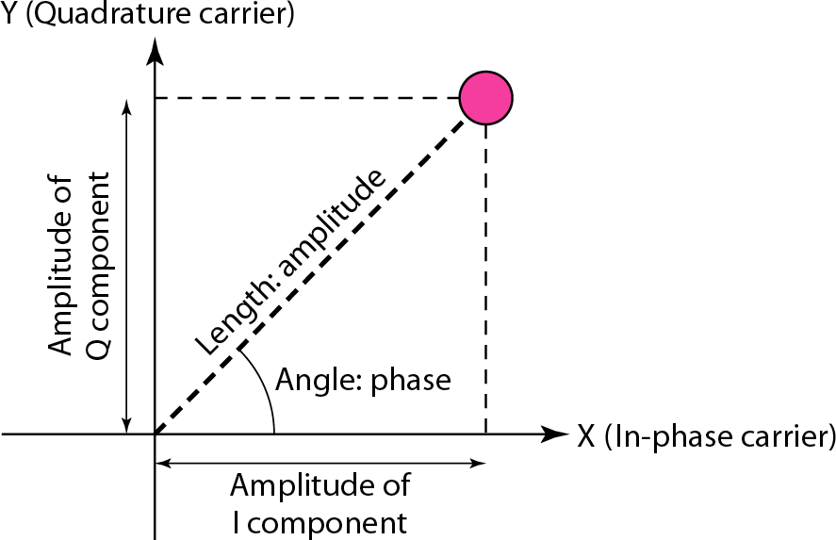
Figure 5.12 Concept of a constellation diagram

Slide 23
Example 5.8
Show the constellation diagrams for an ASK (OOK), BPSK, and QPSK signals.
Solution
Figure 5.13 shows the three constellation diagrams.

Slide 24
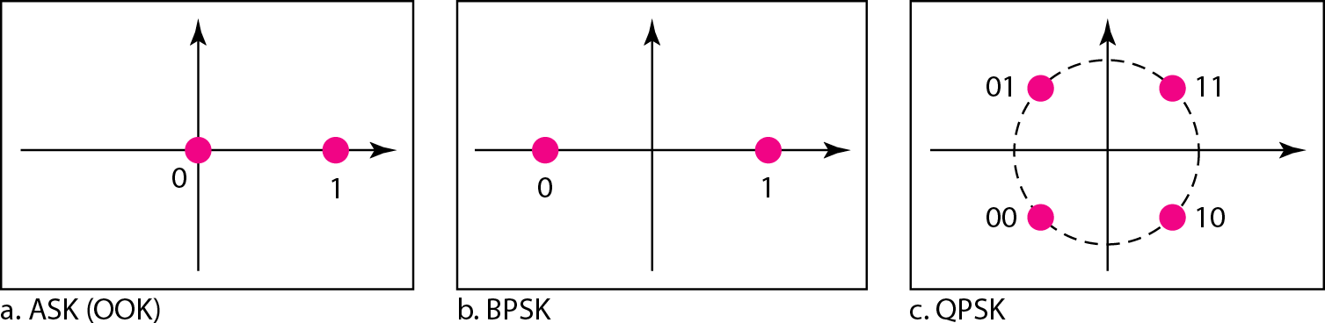
Figure 5.13 Three constellation diagrams

Slide 25
Note
Quadrature amplitude modulation is a combination of ASK and PSK.

Slide 26
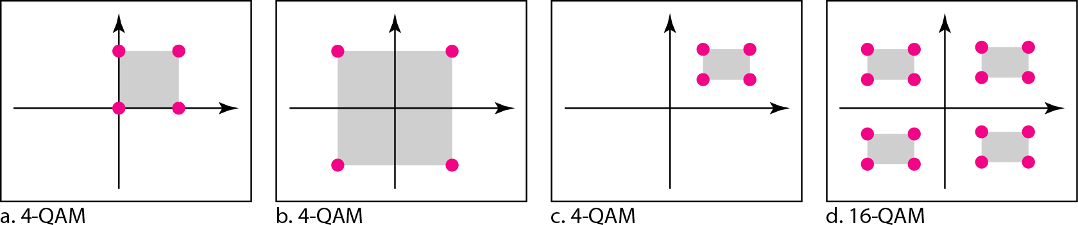
Figure 5.14 Constellation diagrams for some QAMs

Slide 27
5-2 ANALOG AND DIGITAL
Analog-to-analog conversion is the representation of analog information by an analog signal. One may ask why we need to modulate an analog signal; it is already analog. Modulation is needed if the medium is bandpass in nature or if only a bandpass channel is available to us.
Topics discussed in this section:
Amplitude Modulation Frequency Modulation Phase Modulation

Slide 28
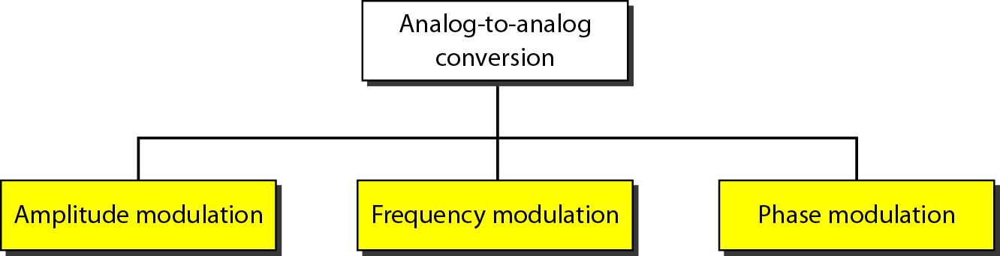
Figure 5.15 Types of analog-to-analog modulation

Slide 29
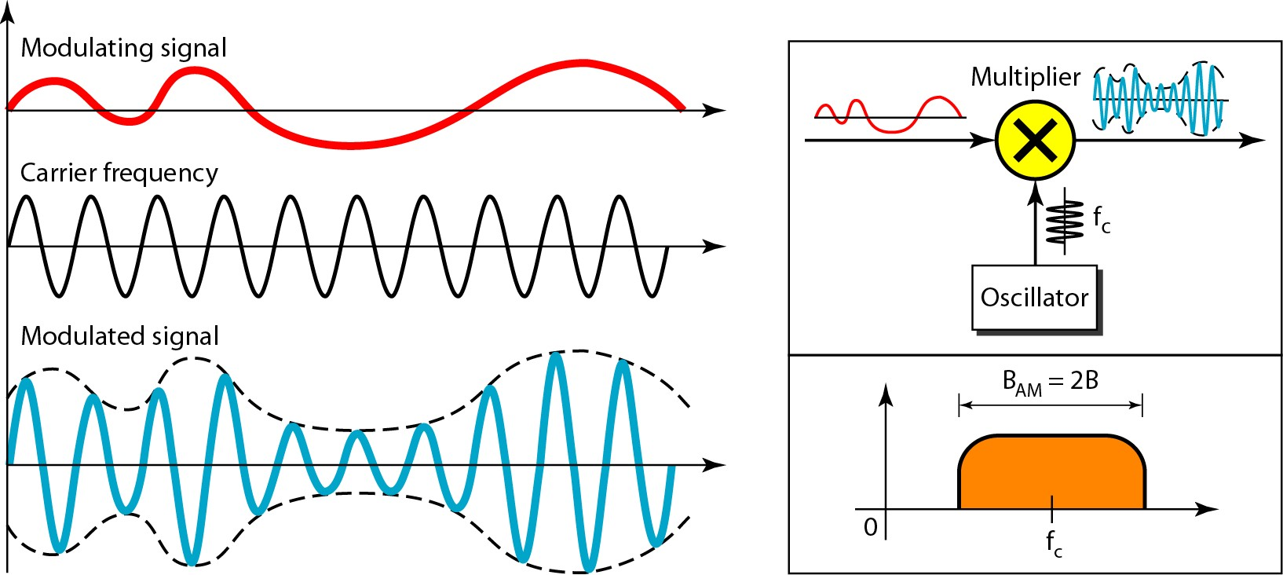
Figure 5.16 Amplitude modulation

Slide 30
Note
The total bandwidth required for AM can be determined
from the bandwidth of the audio signal: B_{AM} = 2B.

Slide 31
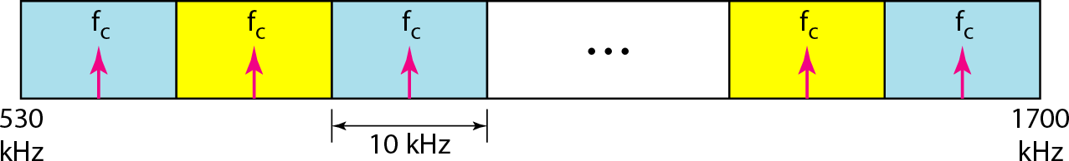
Figure 5.17 AM band allocation

Slide 32
Note
The total bandwidth required for FM can be determined from the bandwidth
of the audio signal: B_{FM} = 2(1 + β)B.

Slide 33
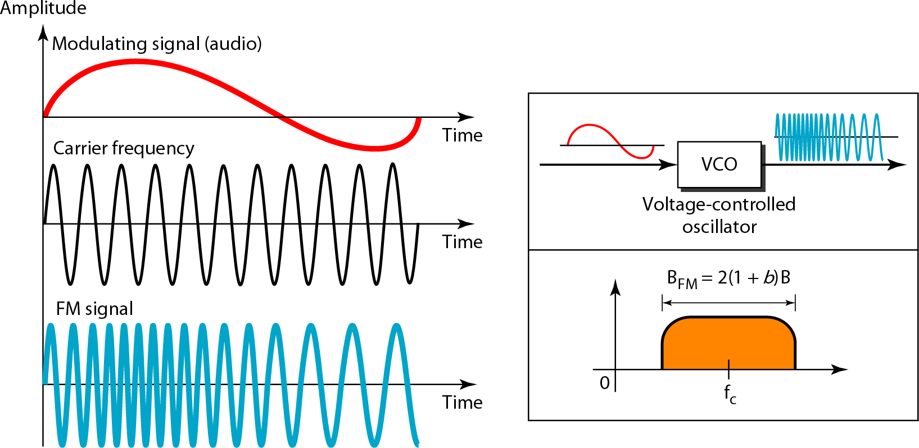
Figure 5.18 Frequency modulation

Slide 34
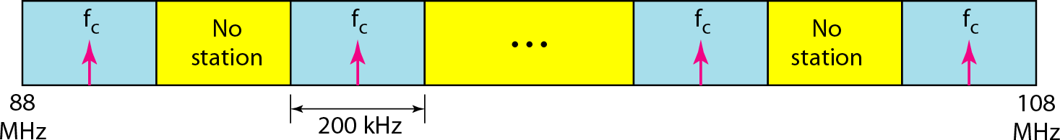
Figure 5.19 FM band allocation

Slide 35
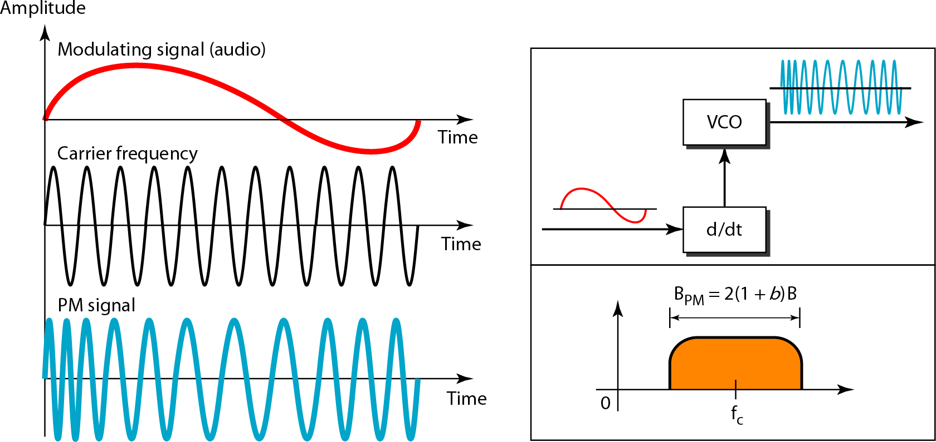
Figure 5.20 Phase modulation

Slide 36
Note
The total bandwidth required for PM can be determined from the bandwidth
and maximum amplitude of the modulating signal:
B_{PM} = 2(1 + β)B.

